Slide 1

Objectives and Constraints
Professor Bo Liu
James Watt School of Engineering

Slide 2


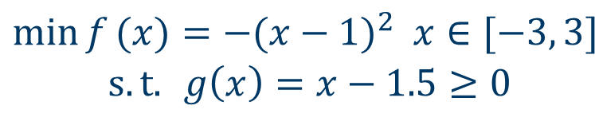
Constrained optimization
Objective vs. Constraint
Objective function
$$\begin{matrix}\min{f}(x)=−(x−1)^{2} x∈[−3, 3] \\ s.t.{ }g\left(x\right)=x−1.5≥0\end{matrix}$$
constraint
0
Feasible space: the feasible space refers to the set of all possible solutions that satisfy a given set of constraints.​
Feasible solution: a solution in the feasible space.​
g(x) ≥ 0

Slide 3
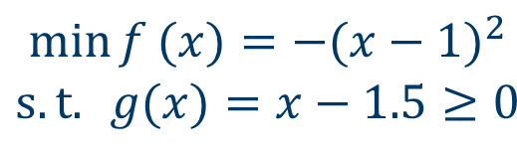
Comparing solutions in constrained optimization
Which solution is the best, and how to compare them?
$$\begin{matrix}\min{f}(x)=−(x−1)^{2} \\ s.t.{ }g(x)=x−1.5≥0\end{matrix}$$
Solution 1​ | x=0.5​ | f(x)=-0.25​ | g(x)=-1​
Solution 2​ | x=1​ | f(x)=0​ | g(x)=-0.5 ​
Solution 3​ | x=1.5​ | f(x)=-0.25 ​ | g(x)=0​
Solution 4​ | x=2​ | f(x)=-1 ​ | g(x)=0.5​

Slide 4
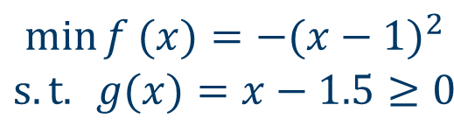
Comparing solutions in constrained optimization
Which solution is the best, and how to compare them?
$$\begin{matrix}\min{f}(x)=−(x−1)^{2} \\ s.t.{ }g(x)=x−1.5≥0\end{matrix}$$
Two feasible solutions:
A feasible solution vs. an infeasible solution:
Two infeasible solutions:
Compare objective function value
The feasible solution is better
Compare the constraint violations

Slide 5
Objectives and constraints
Three elements of an optimization problem: decision variables, objective functions and constraints.
Objective: the smaller the better (considering a minimization problem, how about maximization?)
Constraint: only feasible or infeasible:
  feasible solutions are considered the same.
  infeasible solutions have different quality.

Slide 6
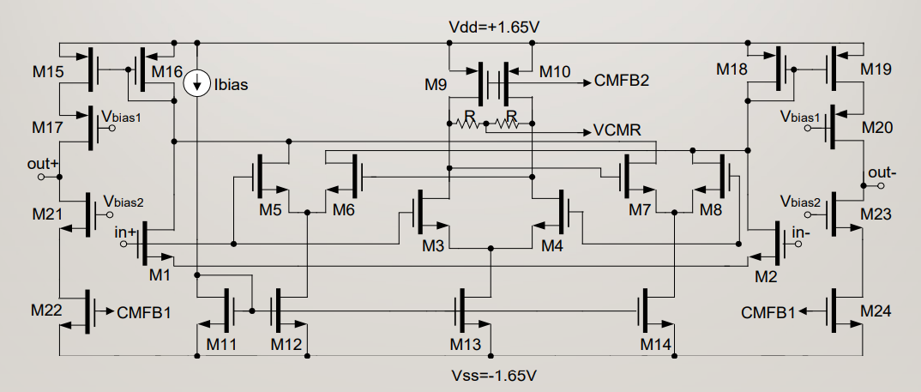
Analog IC design problem
Design variables: W, L of each transistor
min power
s.t. DC gain ≥ 60 dB
Gain bandwidth product ≥ 250 MHz
Phase margin ≥ 60°
Output swing >4V
Slew rate ≥ 2.5 V/μs
Analog IC sizing
You may multiple constraints

Slide 7




Thanks!
#UofGWorldChangers
@UofGlasgow

